Slide 1


Zomato Analysis Project
NAME :
DHEERAJ SINGH

Slide 2

Introduction
KPI’s and insights
Excel dashboard
Tableau dashboard
Recommendations
Challenges
Conclusions
Content

Slide 3


Introduction
Our objective was to analyze Zomato's sales data, uncover trends, and provide actionable insights to enhance business performance. This project involved cleaning the data in Excel, creating calculated fields in Tableau, and using DAX in Power BI to generate interactive dashboards. We focused on understanding customer behavior, identifying top-performing products, and analyzing market trends. The visualizations made it easier to interpret complex data and recognize sales patterns across different regions and time periods. Ultimately, the analysis aimed to support data-driven decisions and improve Zomato’s sales strategies. Additionally, by identifying key performance indicators (KPIs).

Slide 4

Insights
KPIs And
KPIs:
Total Restaurants: 9551
Total Bookings: 12.12%
Total Sales: $96,412.32
Total Votes: 14,98,645
Avg Ratings: 2.89
Insights:
Peak booking time: the highest number of bookings occur at 7 PM, indicating a peak dining time.
Price sensitivity: most restaurants fall under the lower price bucket category, suggesting affordability is a key factor for listings on Zomato.
Financial trends: a significant spike in “yearly audit & return open” during a particular year could indicate a change in financial policy or an event affecting returns that year.
Customer engagement: high total votes and average ratings reflect active customer engagement and feedback.

Slide 5


Insights
KPIs And
Insights:
Geographical Distribution: India has the highest number of restaurants listed, indicating a strong market presence.
Revenue Concentration: The majority of sales revenue comes from a few high-performing cities.
Customer Preferences: Higher average ratings are observed in cities with more diverse cuisine options.

Slide 6
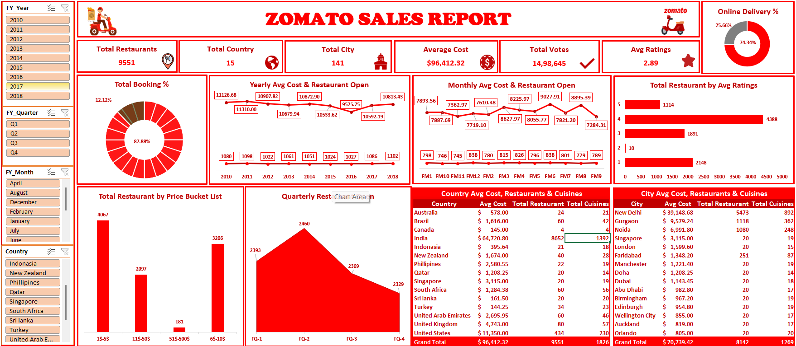
Excel Dashboard

Slide 7
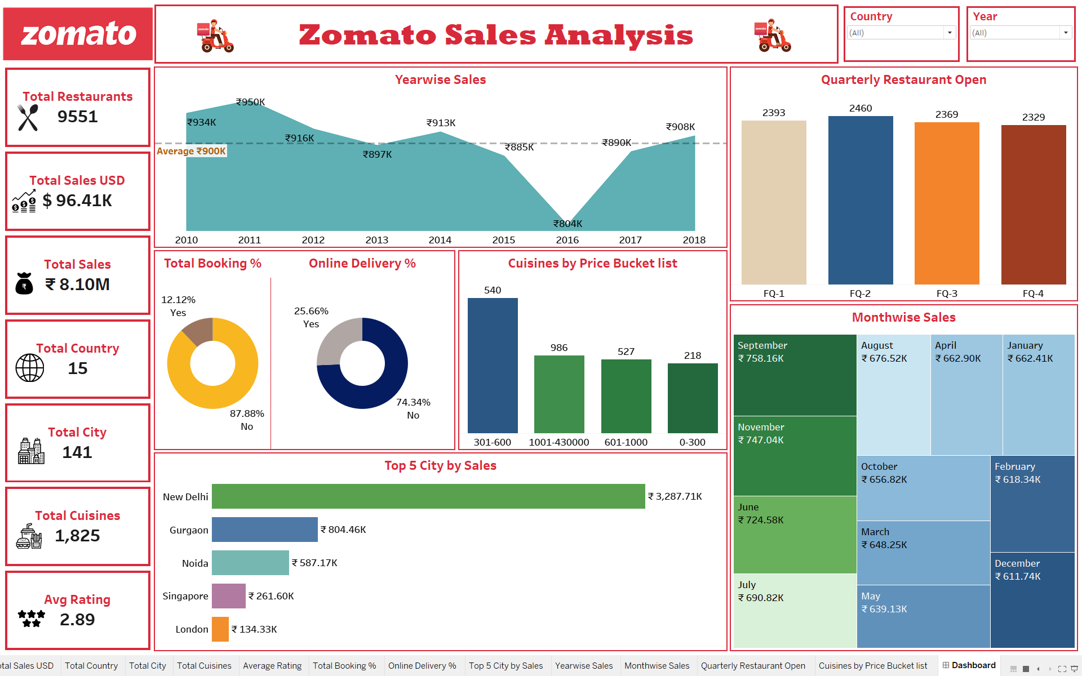
Tableau Dashboard

Slide 8


Recommendations
Targeted Marketing Campaigns: Utilize customer segmentation insights to design tailored marketing campaigns that resonate with specific demographics and preferences. This targeted approach can enhance customer engagement and drive sales in key segments.
Optimize Menu Offerings: Analyze sales data to identify top-performing products and consider promoting or expanding these items. Conversely, review underperforming dishes for potential removal or re-evaluation based on customer feedback, ensuring the menu aligns with customer preferences.
Dynamic Pricing Strategies: Implement dynamic pricing based on demand fluctuations observed in the dashboards. Adjusting prices during peak times or offering discounts during slower periods can help maximize revenue and attract more customers.
Geographic Focus: Leverage regional sales data to identify areas with high growth potential. Increase marketing efforts or consider opening new branches in these regions to capture additional market share and enhance overall sales performance
80% OFF
/ Express Expedition

Slide 9
Challenges
Data Quality Issues: Ensuring the accuracy and completeness of the data can be challenging. Inconsistent formats, missing values, or duplicate entries can hinder the analysis and require extensive data cleaning.
Integration of Multiple Data Sources: Combining data from various sources, such as sales records, customer feedback, and market trends, can complicate the analysis. Ensuring compatibility and consistency across these sources is crucial for reliable insights.
Complexity of Analysis Tools: Mastering various tools like Excel, Tableau, and Power BI can be a steep learning curve. Understanding how to effectively use advanced features, such as DAX in Power BI, can take time and may lead to frustration.
Interpreting Data Effectively: Analyzing large datasets can be overwhelming. Distilling complex data into meaningful insights requires careful interpretation to avoid misrepresenting findings.
Time Management: Balancing project deadlines with the need for thorough analysis can be challenging. Allocating sufficient time for each phase, including data cleaning, analysis, and visualization, is essential for a successful outcome.

Slide 10


Conclusion
The Zomato sales analysis has revealed key insights into customer behavior and product performance. By utilizing advanced data cleaning and visualization techniques, we identified opportunities for targeted marketing and menu optimization, as well as the potential for dynamic pricing strategies. The analysis also highlighted high-growth geographic areas for expansion. These findings will support data-driven strategies to enhance sales performance and customer satisfaction, positioning Zomato for continued growth.

Slide 11

Thank You

